Slide 1
IMT-2020 submission templates: Link budget template
Asbjörn Grövlen
Ericsson

Slide 2
Link budget – what is it?
Assess the maximum supported path loss and range
Downlink and uplink
Data and control
Five test environments: indoor hotspot eMBB, dense urban eMBB, rural eMBB, urban macro mMTC, urban macro URLLC
x dB, y km

Slide 3
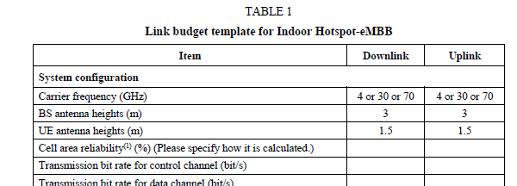
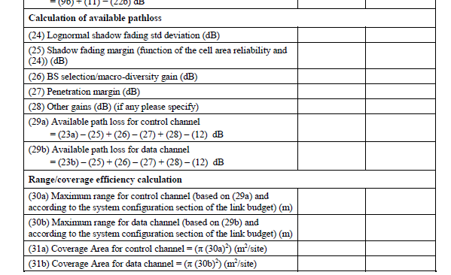
Guidelines from the ITU
Methodology and tables provided in M.2111, 5.2.3.3
One table per test environment
Indoor hotspot, dense urban, rural, urban macro mMTC, urban macro URLLC
Some parameters given by the ITU
Some parameters provided by proponent
Assumptions
Simulation results

Slide 4
Assumptions from 3GPP
NR and LTE
Data represented by PDSCH and PUSCH
Control represented by PDCCH (indicating downlink and uplink resource allocation, modulation and coding) and PUCCH (used for ACK/NACK, scheduling requests, channel quality indication)
For NR TDD, a DDDSU pattern is assumed for downlink and a DSUUD pattern for uplink
Power levels, bandwidths, noise figures, antenna configurations aligned with test environment configurations
Shadow fading and interference margins assumptions
Link performance simulated
Link: RP-182097

Slide 5
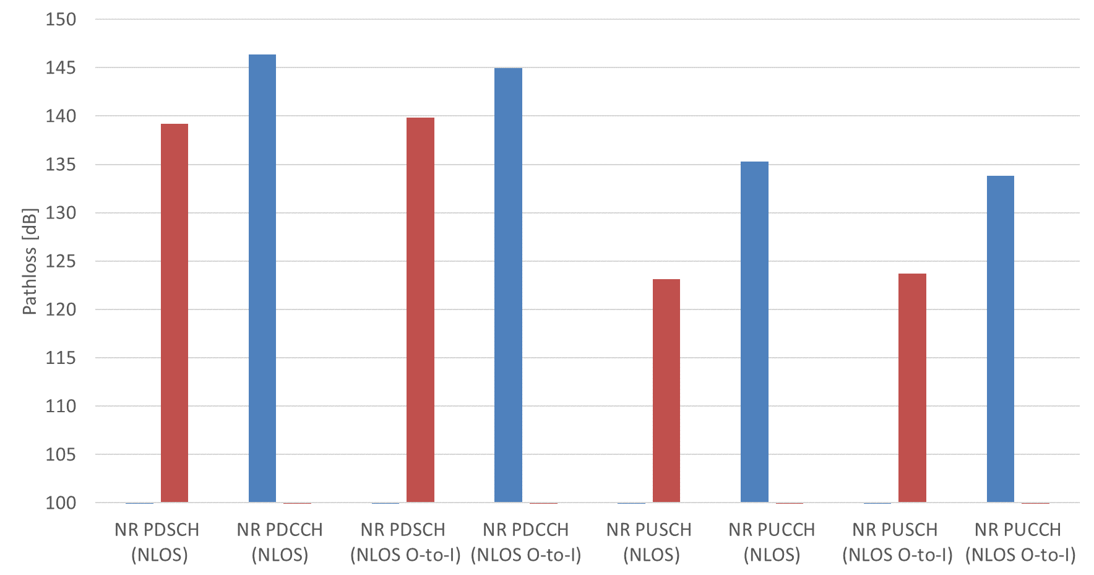
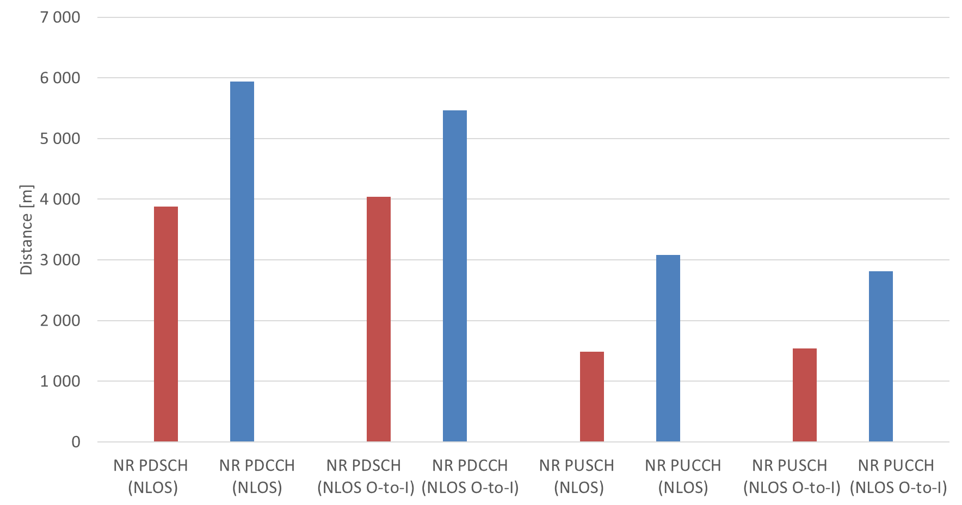
Preliminary results from 3GPP
Full results provided in RP-182097
Example, NR FDD 700MHz, rural, channel model A, 6Mbps DL, 0.5Mbps UL

Slide 6
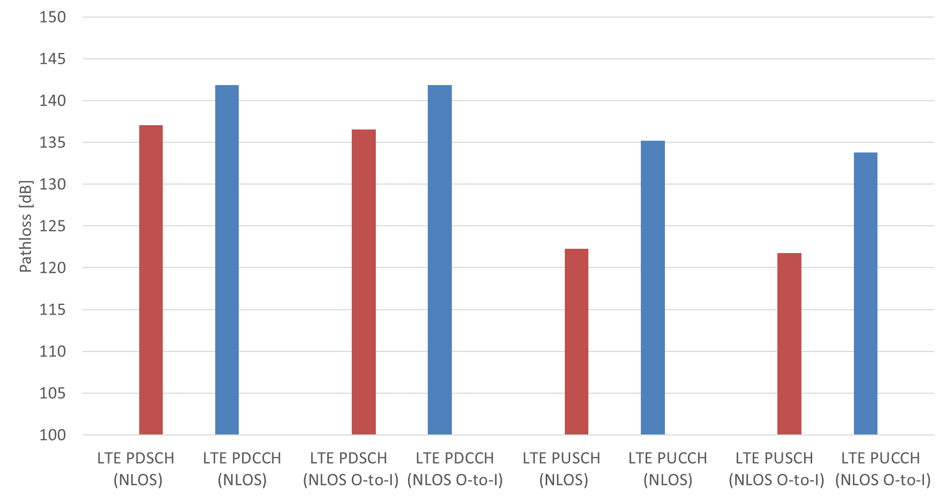
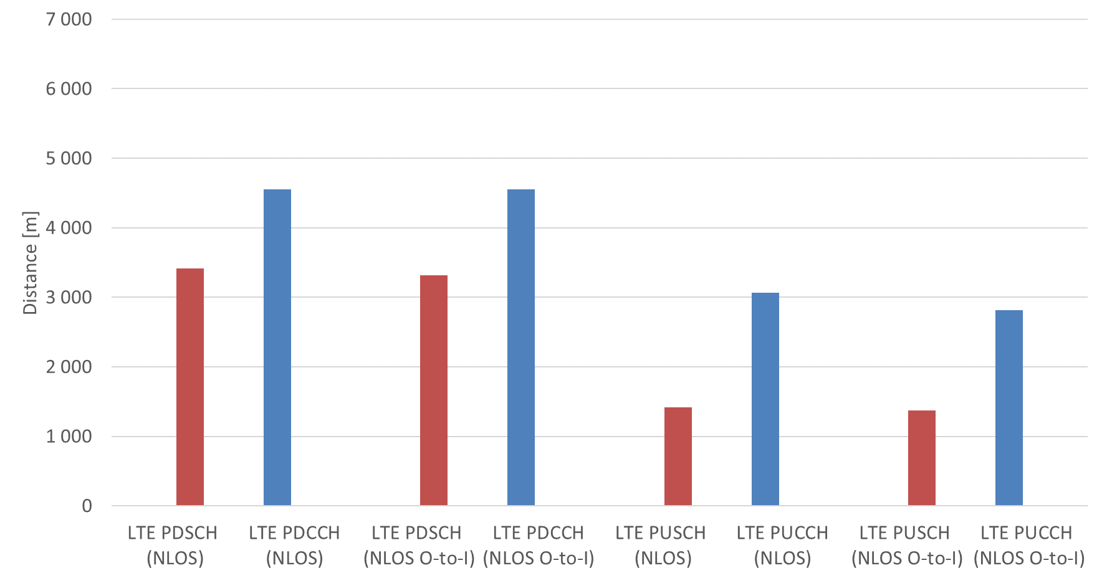
Preliminary results from 3GPP
Full results provided in RP-182097
Example, LTE FDD 700MHz, rural, channel model A, 6Mbps DL, 0.5Mbps UL

Slide 7
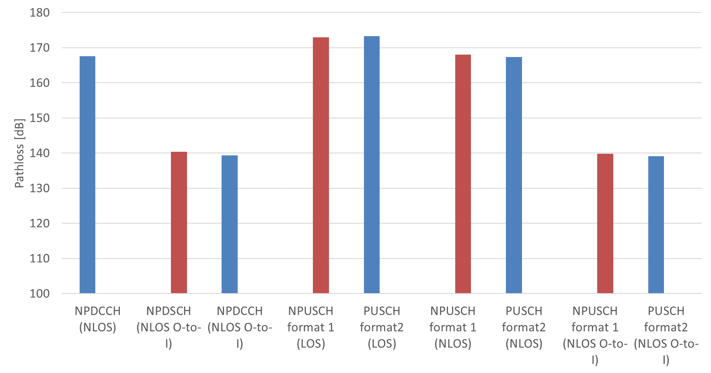
Preliminary results from 3GPP
Full results provided in RP-182097
Example, NB-IoT Uma-mMTC

Slide 8
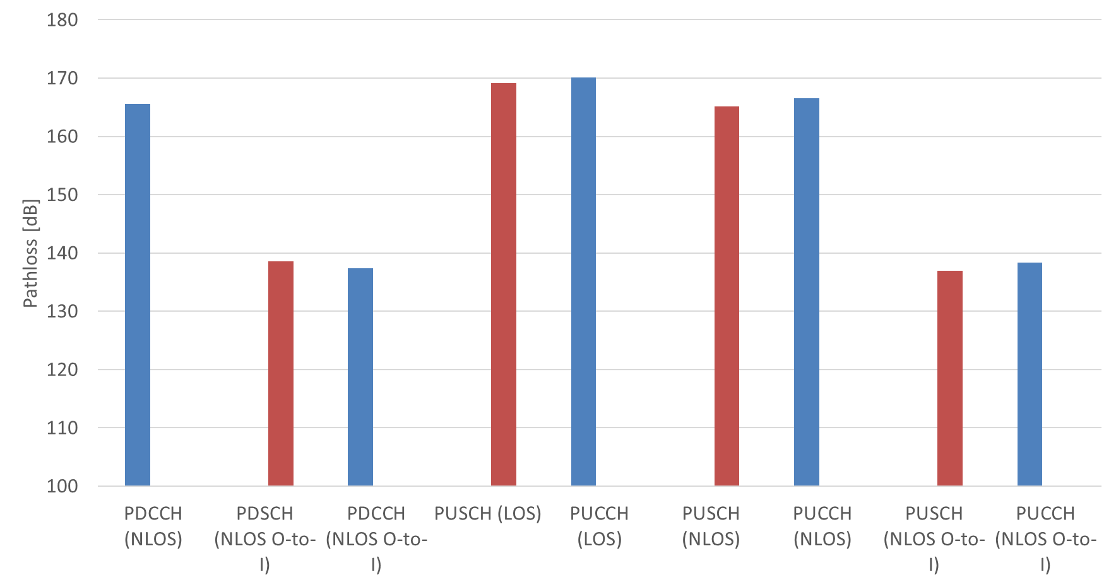
Preliminary results from 3GPP
Full results provided in RP-182097
Example, eMTC, Uma-mMTC

Slide 9


What to do for the evaluation groups?
Verify that parameters are aligned with ITU guidelines
Verify that margins for fading and interference etc. are reasonable
Verify link performance

